Slide 1
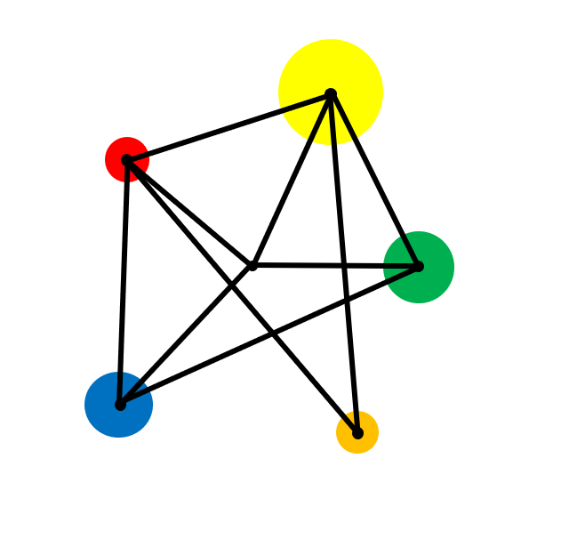
Angle Facts

Slide 2
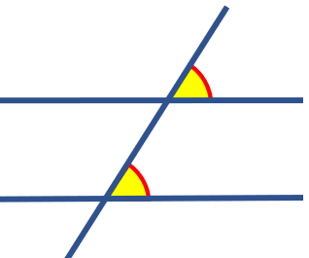
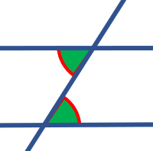
Vocabulary
Angle
A measure of turn. Usually measured in degrees.
Parallel
Lines that are always the same distance apart and never touching.
Corresponding
Angles on parallel lines that are in the same position relative to a line that crosses them.
Alternate
Angles on parallel lines that are in the opposite position relative to a line that crosses them.
Vertically Opposite
The angles opposite each other when two lines cross.
Geometry
The branch of mathematics that deals with points, lines, shapes and space.

Slide 3
Basic Facts
b
i
c
f
a
e
g
h
j
d
a + b + c + d = 360º
e + f + g = 180º
h + i + j = 180º
Angles around a point add up to 360º
Angles on a straight line add up to 180º
Angles in a triangle add up to 180º

Slide 4
Exercise
Find the angles marked with letters. (AB is always a straight line)
85º
b
55º
B
a
140º
c
35º
70º
A
B
A
4e
d
d
f
2d
A
3e
5e
f
70º
B

Slide 5
Answers
b = 130º
85º
a = 75º
55º
B
b
c = 140º
a
35º
70º
c
B
140º
A
A
d = 54º
f = 135º
4e
g = 20º
d
d
f
3d
A
3e
5e
f
70º
B
3d = 162º
3e = 45º 4e = 60º 5e = 75º

Slide 6
Angle Facts to learn
Corresponding angles are equal
Alternate angles are equal
Vertically Opposite angles are equal

Slide 7
Find the angles marked with letters.
a
130º
51º
c
40º
60º
f
b
d
g
e
h
i
j
62º
50º
^{h}
m
n
59º
k
40º
l
r
p
o
s
q
52º

Slide 8
Answers
a = 51º
130º
a
51º
c
40º
60º
c = 51º
f
f = 80º
b = 51º
d
d = 130º
g = 140º
j= 120º
b
g
h = 40º
e
h
i
j
e = 130º
i = 60º
62º
50º
^{h}
m
n
n= 130º
59º
m= 50º
r= 40º
k
40º
l
k= 59º
r
l= 62º
s= 52º
q
p
o
s
52º
p= 130º
o= 50º
q= 88º

Slide 9
Extension
Draw the diagram and measure the yellow angles.
Can you come up with a conjecture?
Can you prove it?

Slide 10
Exam Style Question
D
FG and HI are parallel lines
DE is a straight line
110º
a
F
G
c
b
d
H
I
e
E
Write down the letter of one other angle of size 110º
Give a reason for your answer.
b) Explain why a + b + c = 250º.

Slide 11
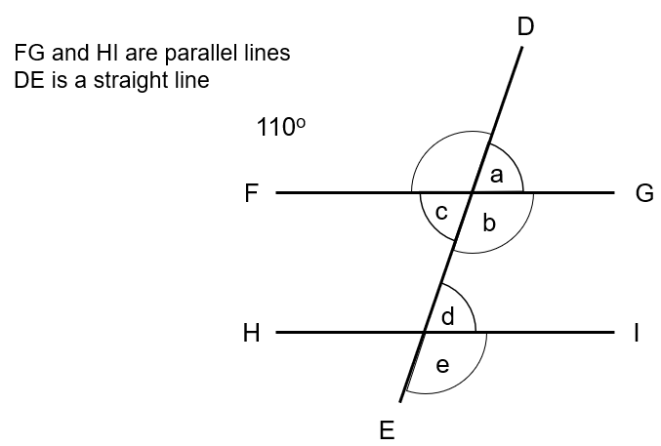
Solution
Write down the letter of one other angle of size 110º
Give a reason for your answer.
Angle b or angle e
b) Explain why a + b + c = 250º.
a + b + c = 250º because the angles around a point equal 360º and 250 + 110 = 360

Slide 12
Where next?
Constructions
Geometric construction is the process of creating geometric objects using only a compass and a straightedge.
It is possible to create almost any geometric object — including circles, squares & triangles — using only these two tools
Trigonometry
This is the study of angles and sides in right angled triangles. It has been studied for hundreds of years and is useful for navigation, surveying & astronomy.
Circle Theorems
The properties of the circle have been studied beyond recorded history. The invention of the wheel is a fundamental discovery of properties of a circle.
The first known theorems about circles are by Thales of Miletus (modern day Turkey) from 650 BC. Book 3 of Euclid's Elements deals with properties of circles.

Slide 13
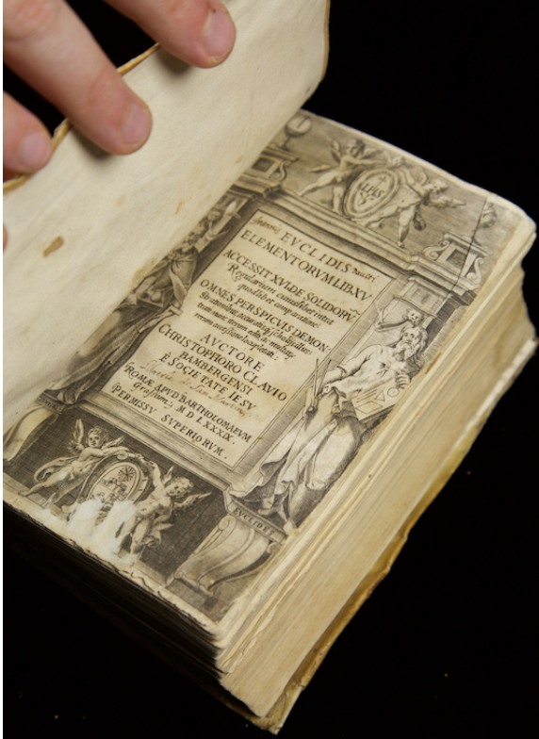
Historical links
The study of angles and geometry can be traced back over 5000 years to ancient Babylonia (modern day Iraq). The people of Babylonia started to collect facts about lines, angles, areas and volumes which helped them to advance their knowledge of surveying, building and astronomy..
The people of Eqypt and Babylon knew Pythagoras’ Theorem about 1 500 years before Pythagoras.
Euclid was born in Alexandria in Egypt in about 325 BC(c. 325-265 BC). He wrote 13 books, together called The Elements of Geometry.wrote a treatise in 13 books (chapters), titled The Elements of Geometry. This was not the first Geometry textbook but it was the best and it was widely studied in schools until the 20th Century. It contained the theorems that we saw earlier.

